Slide 1
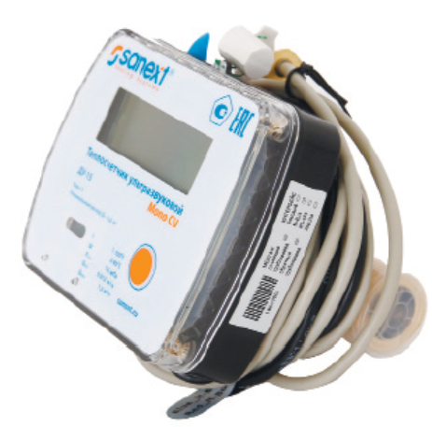
Hardware connection
Concentrator
MBUS
RS485

Slide 2
Protocol description
SANEXT Mono СU with two protocol compatible:
Standard EN13757, reference “telegram-Heat” document
Private protocol of “Ultrasonic Heat Meter UART Protocol”

Slide 3
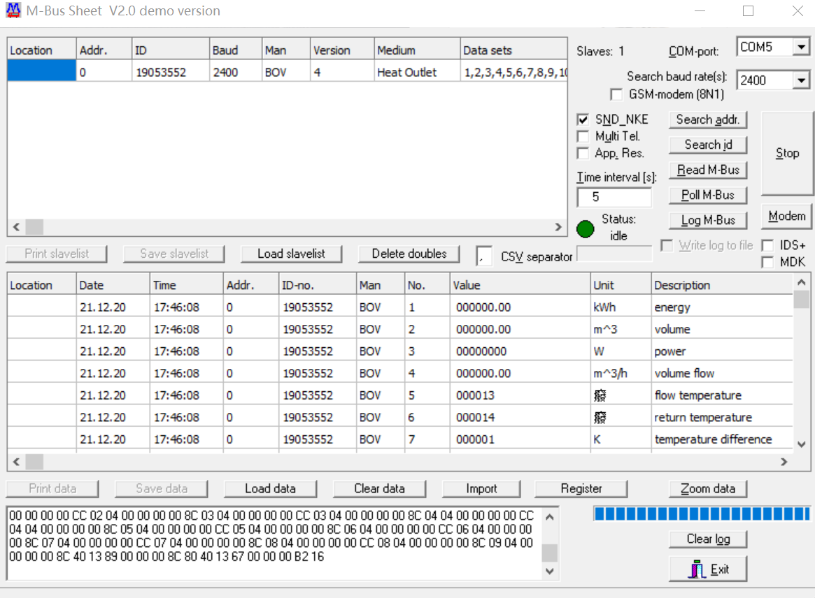
EN13757 Protocol description
68 D4 D4 68 08 00 72 52 35 05 19 F6 09 04 04 02 00 00 00 0C 04 00 00 00 00 0C 14 00 00 00 00 0C 2B 00 00 00 00 0C 3C 00 00 00 00 0B 5B 13 00 00 0B 5F 14 00 00 0B 63 01 00 00 0C 78 52 35 05 19 0B 22 63 88 00 04 6D 14 0F 95 2C CC 00 04 00 00 00 00 8C 01 04 00 00 00 00 CC 01 04 00 00 00 00 8C 02 04 00 00 00 00 CC 02 04 00 00 00 00 8C 03 04 00 00 00 00 CC 03 04 00 00 00 00 8C 04 04 00 00 00 00 CC 04 04 00 00 00 00 8C 05 04 00 00 00 00 CC 05 04 00 00 00 00 8C 06 04 00 00 00 00 CC 06 04 00 00 00 00 8C 07 04 00 00 00 00 CC 07 04 00 00 00 00 8C 08 04 00 00 00 00 CC 08 04 00 00 00 00 8C 09 04 00 00 00 00 8C 40 13 89 00 00 00 8C 80 40 13 67 00 00 00 B2 16

Slide 4
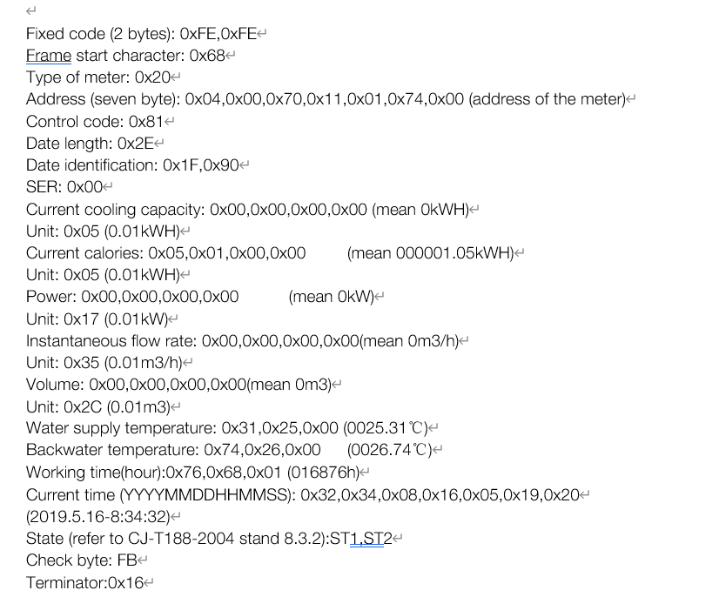
Private Protocol description
Request command:
Use Broadcast address, if only one meter connect to concentrator, the command will be
FE FE 68 20 AA AA AA AA AA AA AA 01 03 1F 90 00 E1 16
Meter response:
The response hex code will be
FE-FE-68-20-52-35-05-19-00-74-00-81-2E-1F-90-00-00-00-00-00-05-00-00-00-00-05-00-00-00-00-17-00-00-00-00-35-00-00-00-00-2C-15-14-00-53-15-00-63-88-00-04-30-15-21-12-20-20-00-08-C1-16

Slide 5
Private Protocol description
Request command:
Use meter serial number as address, if several meters connect to concentrator, the command will be(example the meter serial number is 00740019053552)
FE FE 68 20 52 35 05 19 00 74 00 01 03 1F 90 00 54 16
Meter response:
The response hex code will be
FE-FE-68-20-52-35-05-19-00-74-00-81-2E-1F-90-00-00-00-00-00-05-00-00-00-00-05-00-00-00-00-17-00-00-00-00-35-00-00-00-00-2C-15-14-00-53-15-00-63-88-00-04-30-15-21-12-20-20-00-08-C1-16

